Slide 1
Group Name: Next Level Masters
Cloud Infrastructure Design CCS3316

Slide 2

Group Members
Nethma Pathirana - 21UG0034
Janith Hettiarachchi - 21UG0228
Rasadari Lakshika - 21UG0847
Iffath Hana - 21UG0092
Kesara Lakpriya - 21UG0166
Yeshni - AA2107

Slide 3
Business Case
Develop an online marketplace for selling diverse automobiles, ensuring a user-friendly and secure platform for clients. (http://3.0.189.27/wordpress/)
Allow for easy Vehicle Shopping
Prioritize user data security
Cost-cutting while maintaining performance

Slide 4
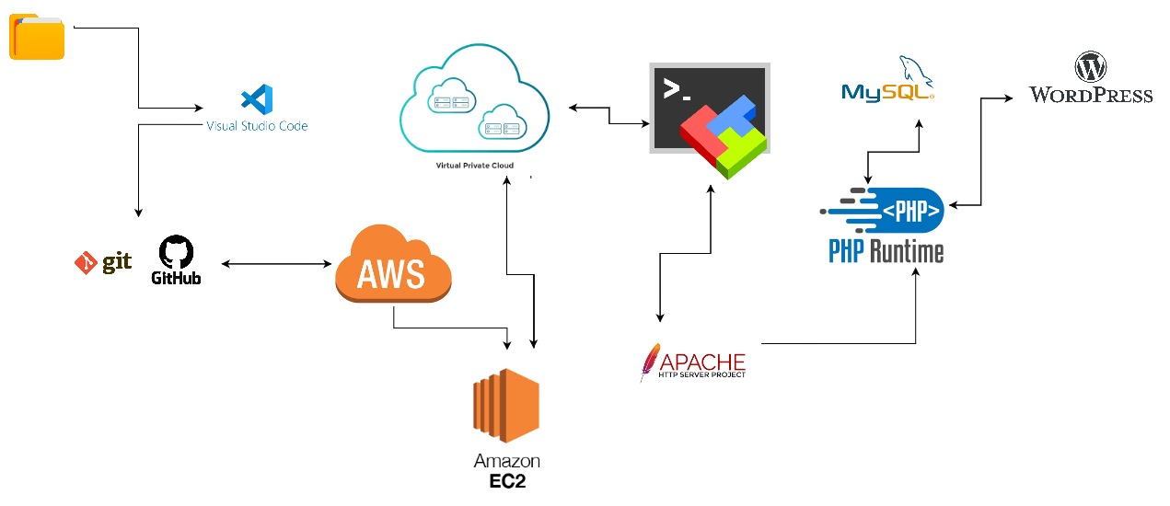
Architectural Diagram

Slide 5
AWS services
The services we used in AWS are VPC, EC2 and S3
Amazon Virtual Private Cloud (VPC)
Amazon EC2 (Elastic Compute Cloud)
Amazon S3 (Simple Storage Service)

Slide 6
AWS Well-Architected Framework
Create an EC2 Instance
Set Up a Virtual Private Cloud (VPC)
Configure Apache Server
Install MySQL and Configure Database
Configure PHP
Install WordPress

Slide 7
Thank You!

